Slide 1

Real Time Financial Performance Analytics Dashboard
Name: Vaibhav Krishna chavva
Student Id: 23095861
Course: MSc data science
Github: https://github.com/Vaibhavkrishna2001/Financial-Time-Series-Analytics

Slide 2

Motivation
Accurately forecasting stock prices supports better-informed investment and risk decisions. Banking stocks are especially interesting to model because they combine steady long-term trends with sharp, event-driven volatility (rate changes, earnings, macro shocks) making them a strong test bed for comparing statistical and machine-learning forecasting approaches.

Slide 3
Introduction
Stock price forecasting has long been a central challenge in quantitative finance accurate predictions inform investment strategy, risk management, and portfolio allocation decisions worth billions of dollars. Over the decades, forecasting approaches have evolved through three broad paradigms:
Classical statistical models: These model price series directly through autocorrelation, trend, and stationarity, offering interpretability and low computational cost.
Machine learning models: capture non-linear relationships between engineered features (lagged prices, moving averages, volume) without assuming a fixed functional form.
Deep learning models: learn temporal patterns directly from raw sequences, well-suited to the sequential, path-dependent nature of financial time series.
Despite extensive individual study of each approach, direct, consistent comparisons across all three paradigms on the same data, with the same evaluation methodology comparatively.
This project focuses on the banking sector, forecasting daily closing stock prices for three major banks Lloyds, Barclays, and Goldman Sachs chosen to span a range of market scales and price volatility profiles.

Slide 4

Research Question
How accurately can the future daily closing prices of major bank stocks (Lloyds, Barclays, and Goldman Sachs) be forecast from their historical price and volume data, and which forecasting approach is best suited to this problem?

Slide 5

Overview of Related Work
Min, J. (2020)
Proposed an LSTM-based financial market trend forecasting method that combines fundamental, technical, and qualitative (sentiment) data in preprocessing, then benchmarked it against existing trend-forecasting models found LSTM's comprehensive multi-source input approach outperformed traditional single-source forecasting techniques.
Box, Jenkins, Reinsel & Ljung (2015)
The foundational text defining the Box-Jenkins methodology for ARIMA modeling: systematic model identification via ACF/PACF analysis, differencing to achieve stationarity, parameter estimation, and residual diagnostic checking. This is the methodology your own ARIMA notebook directly follows (ADF test → differencing → ACF/PACF → grid search → residual diagnostics), making it the theoretical basis for your ARIMA implementation rather than a comparative benchmark like the other three entries.
3. Patel, Shah, Thakkar & Kotecha (2015)
Proposed a two-stage fusion approach: Support Vector Regression first predicts near-term statistical parameters, which then feed into a second-stage model (ANN, Random Forest, or SVR), tested on the CNX Nifty and BSE Sensex indices. Found that all three fusion combinations (SVR-ANN, SVR-RF, SVR-SVR) reduced prediction error compared to single-stage models across 1-30 day forecast horizons.

Slide 6
Difference we are doing in our project
Prior Work
This Project
Usually 1 stock or index
Pairwise comparisons (ARIMA vs RF, or ARIMA vs LSTM) rarely all 3 together
Fusion approaches CHAIN models in stages
Little to no reported hyperparameter tuning
3 banks (Lloyds, Barclays, Goldman Sachs), same pipeline for each
ARIMA, Random Forest, and LSTM run INDEPENDENTLY and compared head-to-head
All 3 models tuned (grid search / RandomizedSearchCV / manual search)
MAE, RMSE, MAPE, and R² reported consistently across every model

Slide 7

Dataset
Source: Yahoo Finance, retrieved via the yfinance Python API
Coverage: 3 banks — Lloyds (LLOY.L), Barclays (BARC.L), Goldman Sachs (GS) daily data, 2 Jan 2015 to 29 May 2026
Format: CSV columns: Date, Bank, Open, High, Low, Close, Volume
Size: 2,868 trading days per bank × 3 banks = 8,600 rows total
Access: https://github.com/Vaibhavkrishna2001/Financial-Time-Series-Analytics

Slide 8
Ethical Considerations
No personal data
The dataset contains only public market prices and volumes no individuals are identified.
Public licensed source
Data is retrieved through Yahoo Finance / yfinance, a widely used public API
No re-identification risk
Stock-level financial data cannot be traced back to any person.
Secure, local storage
Data is stored as local CSV files for the duration of the project and not shared beyond coursework use.

Slide 9
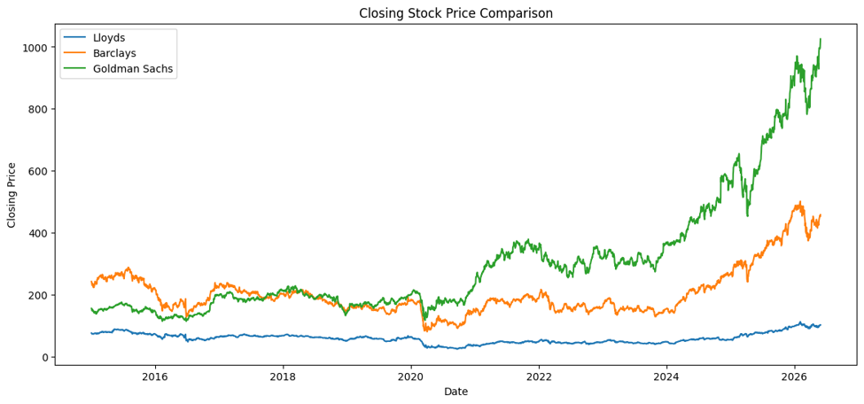
Exploratory Data Analysis
Closing Stock price of All 3 banks
Goldman Sachs
Shows the strongest long-term growth.
Its price went up from roughly 150 in 2015 to more than 1000 by 2026.
It had a big increase after 2020.
This shows good market performance and strong investor confidence.
Barclays
Begun around 240 in 2015.
It saw drops during 2020.
It bounced back strongly after 2023.
By 2026, it had reached about 450 to 500.
Lloyds
Had the lowest stock prices throughout the period.
It dropped a lot during 2020.
It slowly recovered after 2023.
Its growth was much slower compared to Goldman Sachs and Barclays.

Slide 10
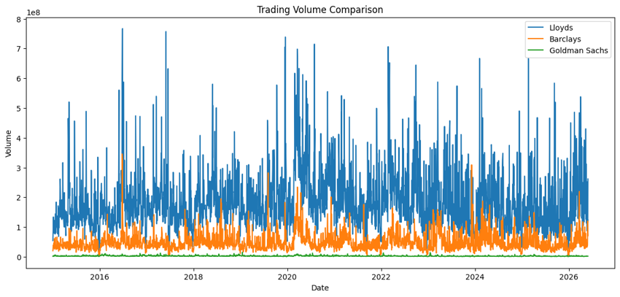
Trading volume Comparision
Lloyds:
Lloyds has the most trades every day.
There are several big jumps where more than 700 million shares were traded.
This shows a lot of people are buying and selling, and there's plenty of liquid market.
Barclays
Barclays has a steady but not very high level of trading.
It's less than Lloyds but more than Goldman Sachs.
Goldman Sachs
Goldman Sachs has the least trading activity.
Its trading pattern is more consistent.
Even though it's not traded as much, its stock price went up a lot.
Important Insight
Just because a company has a lot of trades doesn't mean its stock will grow more.
Lloyds has the most trades.
Goldman Sachs has the biggest price rise.

Slide 11
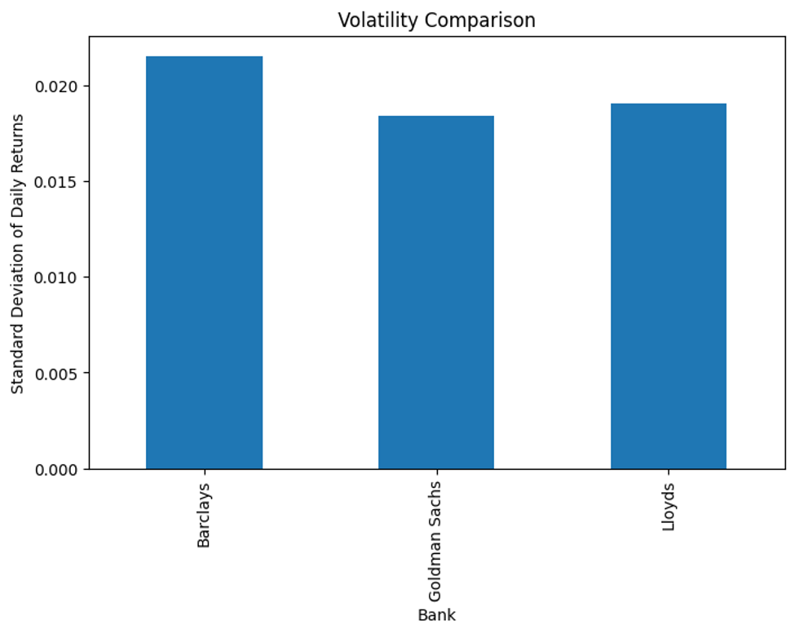
Volatility Comparision
Barclays
Highest volatility.
Most affected by market changes.
Higher risk for short-term investments.
Lloyds
Moderate volatility.
More stable than Barclays.
Goldman Sachs
Lowest volatility.
Surprisingly steady, even though it had strong growth.
Most Important Finding
Goldman Sachs achieved:
Highest long-term growth
Lowest volatility
This mix shows strong and steady market performance.

Slide 12
Pre-processing & Feature Engineering
Cleaning
Feature Engineering
• Drop rows with missing Date
Convert Date to datetime; sort chronologically
Convert Open/High/Low/Close/Volume to numeric
Encode Bank with LabelEncoder
Check duplicates & High/Low logical consistency
Lag features: Lag1, Lag2, Lag3 (previous close)
Rolling averages: MA5, MA10
Date parts: Year, Month, Day
MinMax scaling of Close for the LSTM sequence input
60-step lookback sequences for LSTM
Train-Test Split: 80% train / 20% test, time-ordered (no shuffling) applied consistently across ARIMA, Random Forest, and LSTM.

Slide 13
Models Used
ARIMA
Classical statistical model on the raw closing-price series. Order (p,d,q) selected via ADF stationarity test, ACF/PACF plots, and grid search.
Random Forest
Ensemble of decision trees using engineered features (lags, moving averages, Bank, OHLCV, date parts) to predict Close.
LSTM
Recurrent neural network (2 LSTM layers + Dropout) over 60-day scaled sequences, capturing longer-term temporal dependencies.

Slide 14
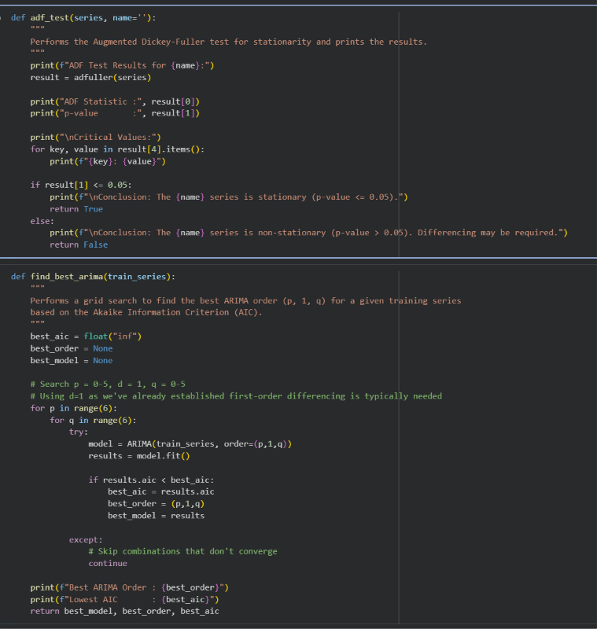
ARIMA — Model & Results
Code:
Order selected per bank by ADF test + grid search over p=0-5, d=1, q=0-5 (lowest AIC). Forecast via rolling one-step-ahead walk-forward on the test set.
Bank | Order | MAE | RMSE | MAPE | R²
Lloyds | (4,1,2) | 0.90 | 1.29 | 1.22% | 0. 9948
Barclays | (0,1,0) | 4.61 | 6.40 | 1.47% | 0.9953
Goldman Sachs | (3,1,5) | 13.73 | 19.19 | 2.15% | 0.9886

Slide 15
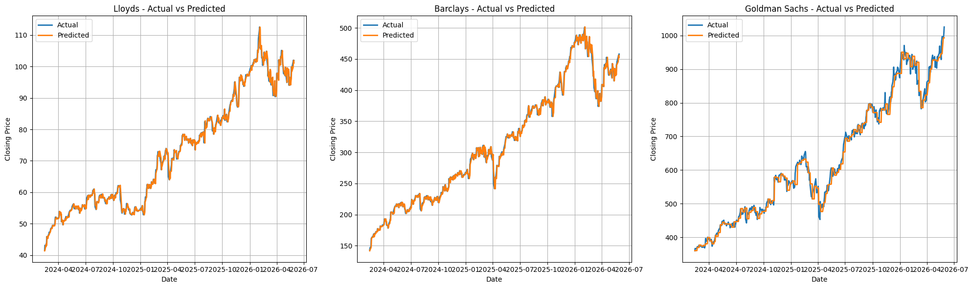
ARIMA Final Results
Important Finding:
Goldman Sachs initially returned R² ≈ -2.1 billion one walk-forward step numerically diverged (optimizer instability on the more complex (3,1,5) order) and wrecked every metric. Added a guard that detects any single-step forecast implying an unrealistic >50% price jump and falls back to a persistence value for that step 5 of 574 steps were caught and corrected, producing the clean R² = 0.9886 above.

Slide 16
Random Forest - Model & Results
Tuned via RandomizedSearchCV with TimeSeriesSplit (20 candidates × 5 folds) over Bank, OHLCV, Lag1-3, MA5, MA10, with a time-ordered 80/20 split across all 3 banks combined.
MAE
5.25
RMSE
8.85
R²
0.9988
Fix that got it here: predict price CHANGE, not price LEVEL
n_estimators=100 · max_depth=None · min_samples_split=2 · min_samples_leaf=1 · max_features=1.0 (CV MAE=1.69, on the change-scale target)
Random Forest first scored only R²=0.498 predicting Close directly — diagnosed as a tree-model extrapolation failure: Goldman Sachs' test period is ~96% “record highs” never seen in training, and trees can't predict beyond their training range. Retargeting to predict (Close − Lag1) and reconstructing the price fixed it: R² 0.498 → 0.9988.

Slide 17
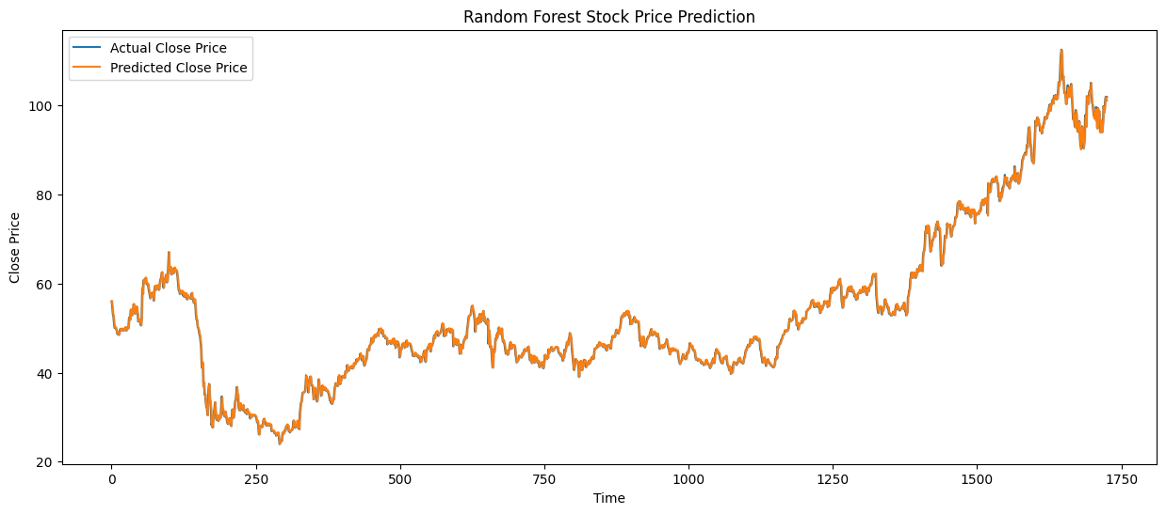
Random Forest - Graphs

Slide 18
LSTM - Model & Results
2-layer LSTM with Dropout, trained on 60-step MinMax-scaled sequences of Close price (per bank, to avoid cross-bank leakage), tuned then trained for 30 epochs.
MAE
20.19
RMSE
37.64
R²
0.9788
Fix applied: scalers must be fit on TRAINING data only
units=100 · dropout=0.2 · batch_size=32 · learning_rate=0.001
Each bank's MinMaxScaler was originally fit on its full series (train + test together) a data-leakage bug, since the scaler implicitly “knew” future prices. After fixing it to fit on training data only, R² dropped from an inflated ~0.996-0.999 to a more honest 0.9788. Still a strong result just an accurate one now, not an inflated one.

Slide 19
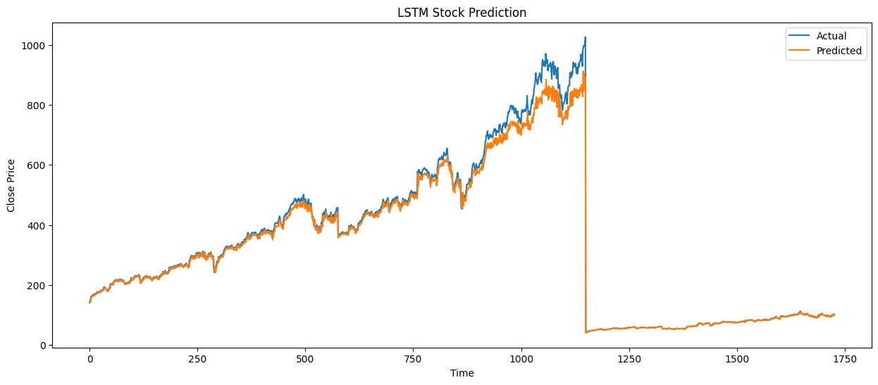
LSTM - Graphs

Slide 20
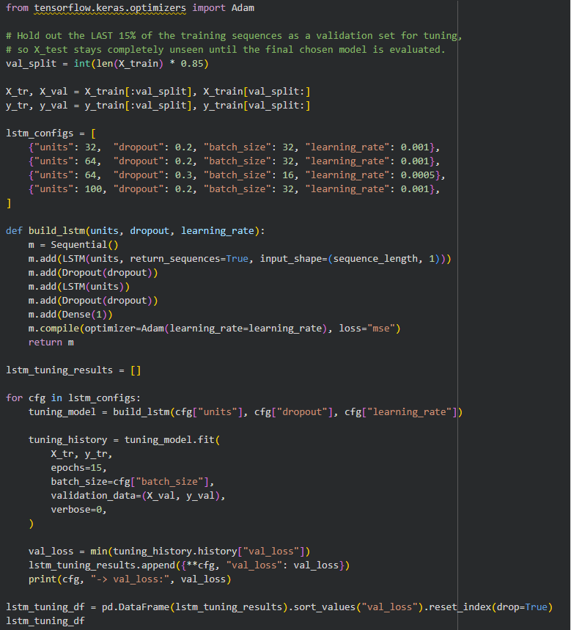
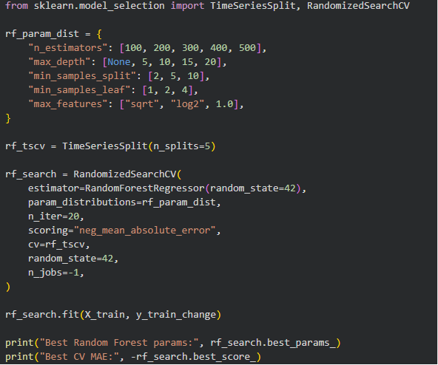
Hyperparameter Tuning
ARIMA
Grid search, per bank
p = 0–5, q = 0–5, d = 1 (fixed by ADF test)
36 combinations fit per bank\
Selected by lowest AIC
Lloyds (4,1,2) · Barclays (0,1,0) · Goldman (3,1,5)
Random Forest
RandomizedSearchCV
20 candidates × 5 TimeSeriesSplit folds
n_estimators, max_depth, min_samples_split/leaf, max_features
Scored by neg. MAE
n_estimators=100, max_depth=None, min_samples_split=2, leaf=1 (CV MAE 1.69)
LSTM
Manual search (4 configs)
units ∈ {32,64,100}, dropout ∈ {0.2,0.3}
batch_size ∈ {16,32}, lr ∈ {5e-4,1e-3}
15-epoch trial runs, held-out validation split
units=100, dropout=0.2, batch=32, lr=0.001 (val_loss 3.2e-4)

Slide 21
Model Comparison
Model | MAE | RMSE | MAPE | R²
ARIMA (avg. of 3 banks) | 6.41 | 8.96 | 1.61% | 0.9929
Random Forest | 5.25 | 8.85 | -- | 0.9988
LSTM | 20.19 | 37.64 | -- | 0.9788
Random Forest leads on R² (0.9988) after fixing a tree-model extrapolation bug, narrowly ahead of ARIMA (0.9929) and LSTM (0.9788, after fixing a separate data-leakage bug). All three are strong ARIMA remains the cheapest and most interpretable for near-identical accuracy.

Slide 22
Analysis
Results?
Yes, all three models now explain 97.9%–99.9% of variance (R²). That range only emerged after fixing three separate bugs; the raw numbers were badly misleading beforehand.
Why did Random Forest underperform?
RF first scored R²=0.498 predicting price LEVELS directly trees can't extrapolate beyond training range, and Goldman's test period is ~96% “record highs.” Predicting price CHANGE instead fixed it: R² 0.498 → 0.9988.
Is LSTM's R² really that impressive?
Each bank's scaler was fit on its FULL series (train+test), leaking future price info into training. Fixing it to fit on training data only dropped R² from an inflated ~0.996-0.999 to an honest 0.9788 still strong, now trustworthy.
What did debugging teach?
Three independent bugs (ARIMA numerical divergence, RF extrapolation, LSTM leakage) all looked like “model underperformance” until traced to root cause. Headline metrics alone don't catch this walk-forward validation, plot inspection, and train/test boundary checks did.

Slide 23
Summary & Conclusions
Applied ARIMA, Random Forest, and LSTM to forecast daily closing price from historical OHLCV data for 3 banks (Lloyds, Barclays, Goldman Sachs).
All three models tuned (ARIMA: per-bank grid search; RF: RandomizedSearchCV; LSTM: manual config search) and evaluated with MAE, RMSE, and R².
Fixed 3 separate bugs (ARIMA numerical divergence, RF extrapolation, LSTM data leakage) that were masking true performance; final R²: RF 0.9988, ARIMA 0.9929 (avg.), LSTM 0.9788 all genuinely strong.
Next steps: Implementing (Under process) XGBoost + GRU + BiLSTM + CNN-LSTM. So That i can use the advanced Deep learning models and see how it works.

Slide 24
References
Min, J. (2020). Financial Market Trend Forecasting and Performance Analysis Using LSTM. arXiv:2004.01502. https://arxiv.org/abs/2004.01502
Box, G. E. P., Jenkins, G. M., Reinsel, G. C., & Ljung, G. M. (2015). Time Series Analysis: Forecasting and Control (5th ed.). https://www.researchgate.net/publication/299459188_Time_Series_Analysis_Forecasting_and_Control_5th_Edition_by_George_E_P_Box_Gwilym_M_Jenkins_Gregory_C_Reinsel_and_Greta_M_Ljung_2015_Published_by_John_Wiley_and_Sons_Inc_Hoboken_New_Jersey_pp_712_ISBN
Patel, Jigar & Shah, Sahil & Thakkar, Priyank & Kotecha, Ketan. (2014). Predicting stock market index using fusion of machine learning techniques. Expert Systems with Applications. 42. 10.1016/j.eswa.2014.10.031. https://www.researchgate.net/publication/268823054_Predicting_stock_market_index_using_fusion_of_machine_learning_techniques
yfinance (2024). Yahoo! Finance market data downloader [Python package]. https://github.com/ranaroussi/yfinance

Slide 25
Thank You

